Slide 1

WAB Tiger Commerce
WAB DAD|Link Project 2018/19
Jim James
jimajames@icloud.com
Issue: 28.08.2018

Slide 2
Objectives
Offer WAB Tiger merchandise to customers 24/7
Increase merchandise sales contribution to Parent Link
Reduce the work load on the Tiger Shop volunteers
Enable WAB Alumnus to continue to support WAB
Reduce costs of merchandise by increasing volume

Slide 3
The business case

Slide 4


Merchandise
Sell existing and new WAB related goods & services.
Offer 3rd parties to sell merchandise on the site without Parent Link taking stock.
Sell school supplies currently not available.
Offer student developed products for sale.

Slide 5
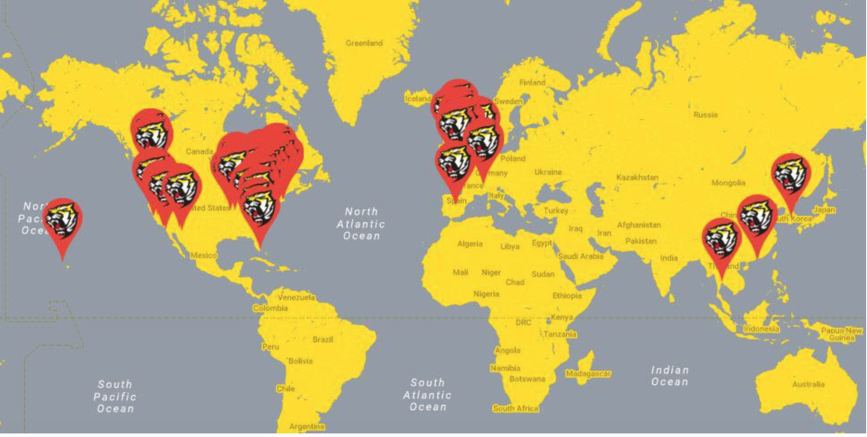
The potential market
Potential WAB market for merchandise:
Current students & parents
The 5000+ WAB Alumni Network
https://www.econsultancy.com/blog/69318-how-do-we-find-a-solution-to-the-great-shopping-cart-abandonment-problem

Slide 6
Storefront

Slide 7
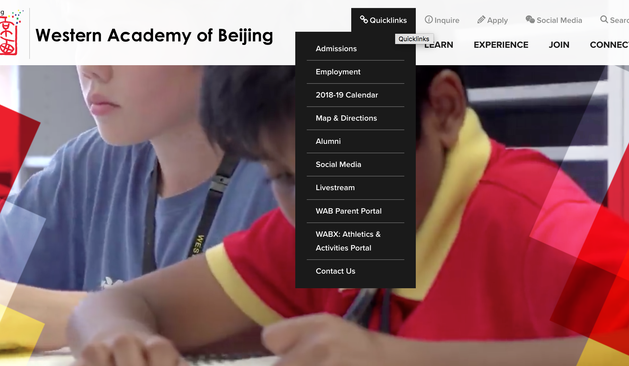
Easy to find the shop
Buy things
Can link to on-line store

Slide 8
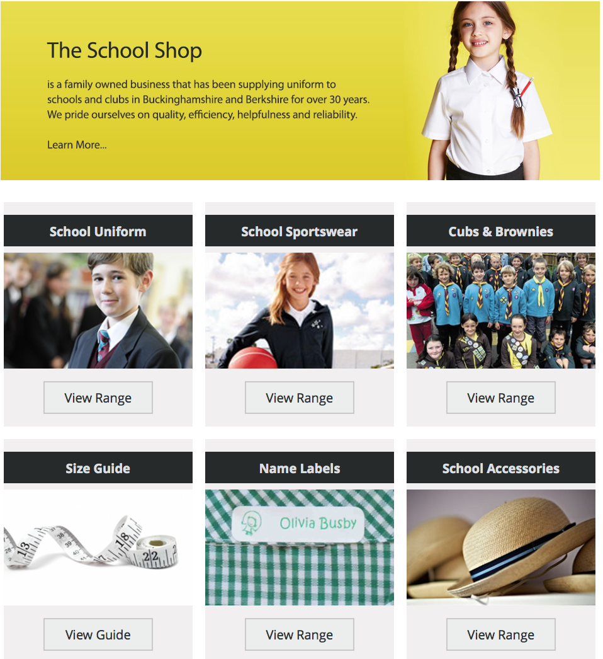
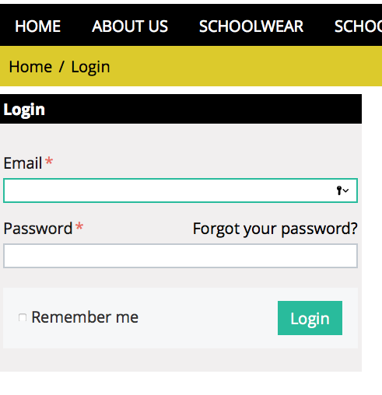
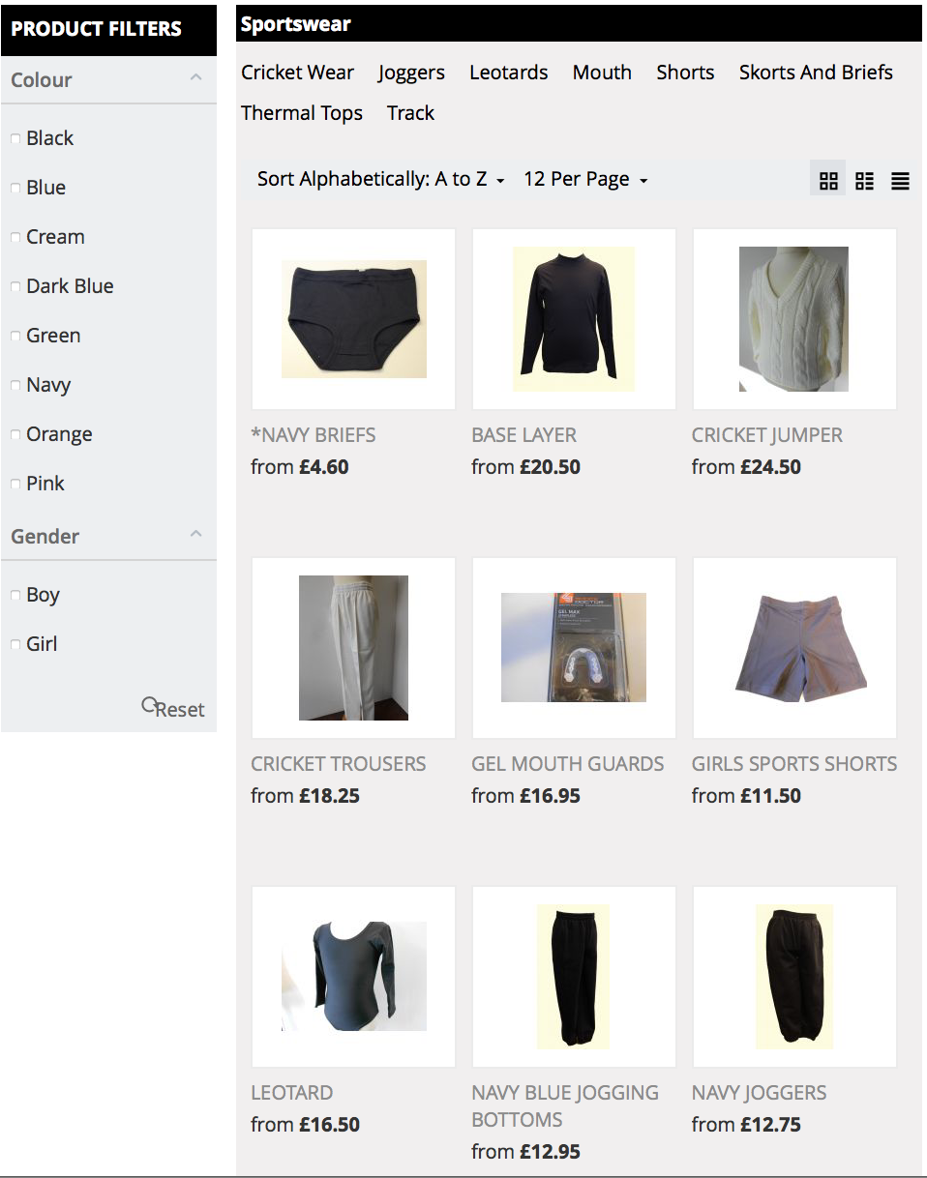

http://wab.edu/shop
The internet shop

Slide 9
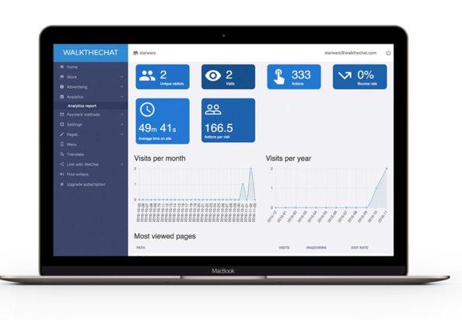
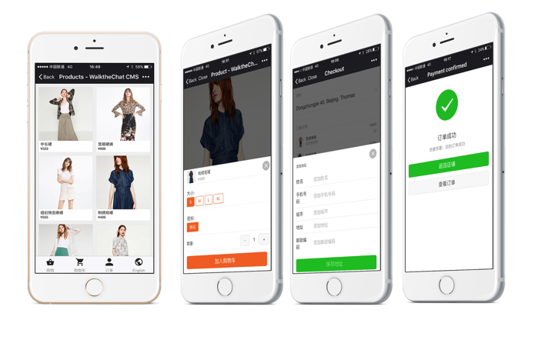
Wechat store
https://walkthechat.com/wechat-shops/

Slide 10
Merchandise selection
Sports kits
Food & beverage containers
Swim wear
Stationery & art supplies
Tickets to events

Slide 11
Features to consider
Storefront:
Professional themes available
Mobile commerce ready
Ability to brand the store
Ease of maintenance
Inventory system
Payment system
Use of own domain name e.g. wab.shop.
Store:
SSL encryption
Credit card & alternative payment gateways e.g. wechat/alipay/paypal
Language
Backroom:
Integrated with shipping
Tax calculation
Fapiao generation
Store management:
Customer profile
Customer account creation
Fulfilment centre connection
Refunds
Email templates
Order fulfilment
Marketing: SEO optimised
Generate Site map automatically
Discounts across the platform
Gift cards
Social media integration
Product reviews by customers
Email marketing integration
Product:
Inventory management
Product variants
Product organisation e.g. category
Multiple images per product
Digital product direct download
Import/export csv
Analytics:
Dashboard
Product reports

Slide 12
Technology

Slide 13
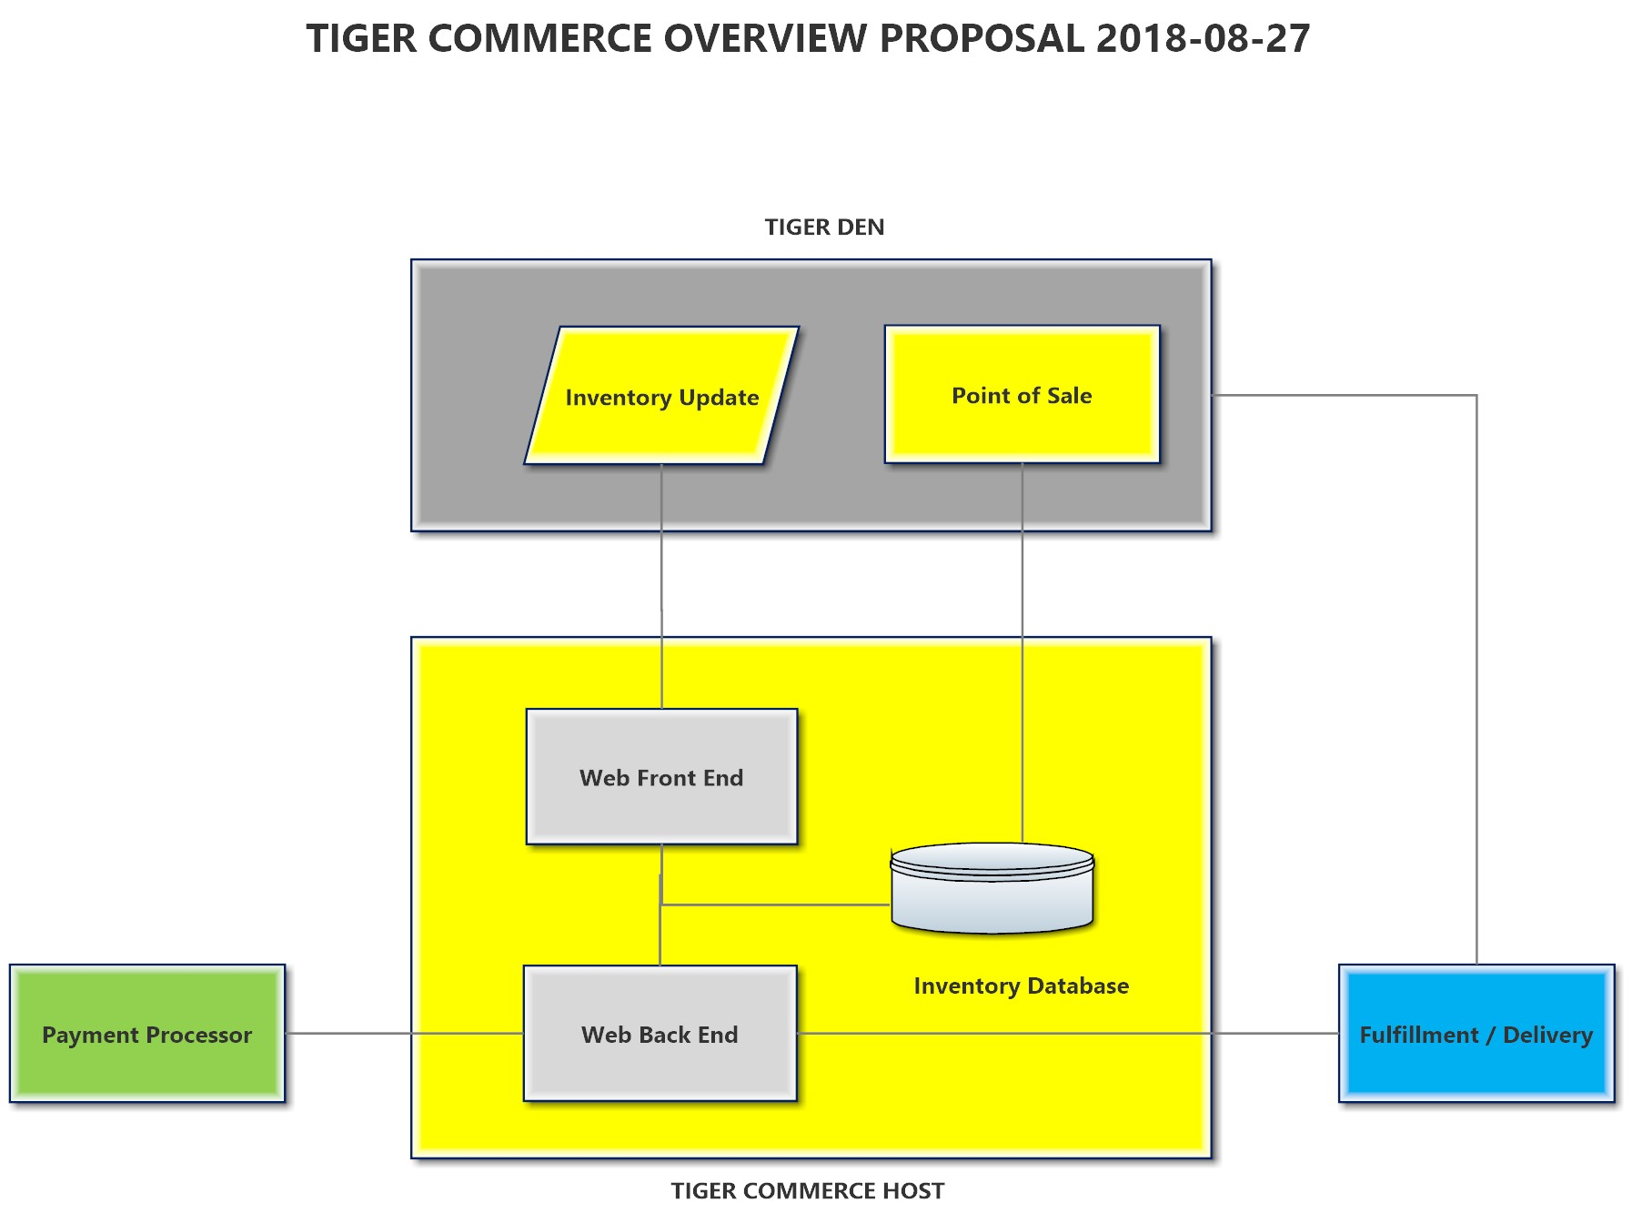
Technology overview

Slide 14
Sample vendors
https://www.shopify.com
https://apps.shopify.com/wechat-social-login
https://walkthechat.com

Slide 15
Finance

Slide 16
Detailed budget

Slide 17
Budget
Assume 1,000 students spend average of RMB150 per year in year one.
N.B. Currently no visibility into Tiger Den revenues.

Slide 18
Promotion

Slide 19
Marketing
Promotion of the store
In store
Via wab weekly
Social media
Print advertising

Slide 20
Schedule

Slide 21
Timeline
 | Phase I | Phase II | Phase III | Phase IV | Phase V | Phase VI
Planning | August
Agree Implementation | Sept
Approvals |  | Sept | Oct | Oct | Nov
Catalogue of merchandise | August | Sept
Selection of technology platform |  |  | Sept
Photography of merchandise |  | Sept | Sept | Oct
Upload of content |  |  |  | Oct
Design storefront |  |  | Sept | Oct
Trial purchases |  |  |  | Oct | Nov 4th
Connect to WAB site |  |  |  |  | Nov 11th
Soft Launch |  |  |  |  | Nov 25th
Full Launch |  |  |  |  |  | Dec 1st

Slide 22
Research

Slide 23
Questions to answer
Management of a virtual store is going to create more work outside of current office hours.
Identify skillsets required.
Full inventory of the Tiger shop required including cost price & sale price
Sales of inventory to be determined ie. best sellers
Which technology platforms to used
Who will be responsible for the development, management and marketing.
Financial expectations in terms of returns.
Who will choose the inventory to be sold
How will we manage fulfilment of the products sold
Payments & refunds & fapiao
The integration of the Tiger Den with Tiger Commerce

Slide 24
Team

Slide 25
The Team (no order)
Jim James - jimajames@icloud.com
Built internet content syndication business, imports sports cars to China, runs a PR agency.
Victor Wang - omnivic@gmail.com
Designed and implemented the first online rewards system in Asia. Understanding of ecommerce growth trend.
Fully fluent in Mandarin and English. May need Mandarin down the line
Able to navigate through various registration process on all ecommerce platforms as seller.
Rob Hackett - rob@thaxra.com
Former director of online at SnapTV, technology specialist at THALES using Android, inflight entertainment specialist
Michael Christiansen - michael_christiansen@wab.edu
COO/CFO at WAB

Slide 26
WAB Tiger Commerce
WAB DAD|Link Project 2018/19
Jim James
jimajames@icloud.com
Issue: 28.08.2018

